Slide 1
Project-1 (1-2 teams) Build the Future with AI: Intelligent Browser Agents
Dr. Zihang Zou, Zihang.Zou@optixway.com
Dr. Liqiang Wang, Liqiang.Wang@ucf.edu

Slide 2


Why AI, Why Now
AI is no longer science fiction — it’s powering assistants, search, tutoring, and decision-making.
LLMs like GPT-4 can read, plan, and explain while they can’t interact with the web.
Current AI agents, such as ChatGPT agent, are slow, expensive, and inaccurate for some specific tasks.
That’s where you should come in: building agents that can read, think, and act online.
Example: we want to find a lawn company to replace our lawns, the agent should be able to identify the contact information. In this case, it should return phone number, email,social media links such as facebook link and yelp contact.
The internet contains a tremendous amount of information, and smart agents can help users quickly find answers and solutions by browsing and understanding websites.

Slide 3






Key Technologies
Browser Automation
Tools: Playwright, Selenium, Puppeteer
Team Focus: Automates web navigation, clicking, data scraping
Web Data Processing
Tools: HTML DOM, XPath, BeautifulSoup
Team Focus: Extracts clean information from messy or visual web content
Large Language Models (LLMs)
Tools: GPT-4, Claude, Gemini
Team Focus: Interprets user questions, plans actions, and generates responses
Join us to:
Build AI agents that think, browse, and chat
Use LLMs, automation, and agent logic
Join a team solving real-world problems with real AI
Agent Frameworks
Tools: LangChain, AutoGen, CrewAI
Team Focus: Builds reasoning pipelines, task planning, and tool coordination

Slide 4
Challenges and FUNS!
Dynamic web environment:
Websites change frequently, use popups, and load content dynamically, which breaks automation scripts.
Vague user intent:
Users often ask broad or unclear questions, and agents must guess the real goal.
Reasoning and decision-making:
Agents need to plan multi-step actions without fixed rules or labeled paths.
Messy and unstructured data:
Useful content is hidden in HTML, visuals, or inconsistent formats that are hard to parse.

Slide 5
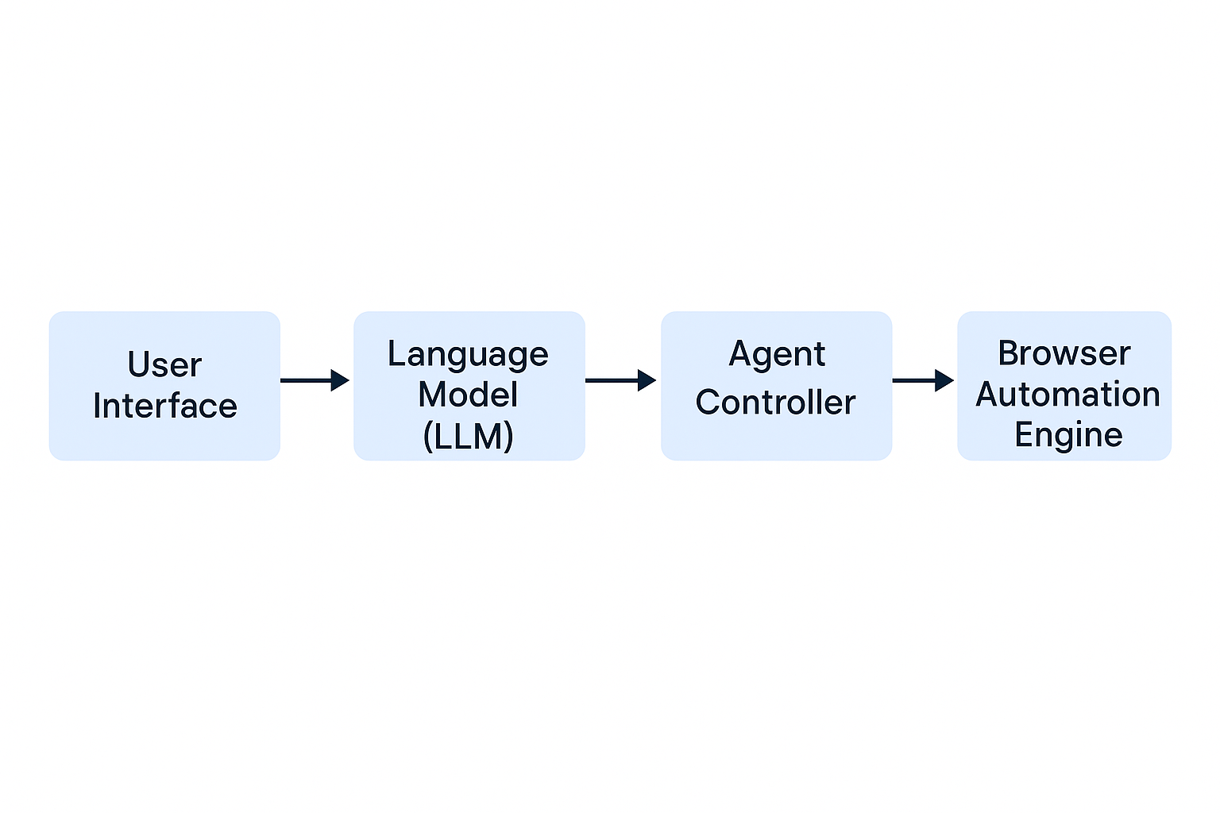
System Architecture Overview
User Interface: A chat box where users ask questions or give instructions.
Language Model (LLM): Understands the query and decides what actions the agent should take.
Agent Controller: Breaks down tasks into steps and chooses tools to use (e.g. browse, extract, summarize).
Browser Automation Engine: Opens web pages, clicks, scrolls, and scrapes information.

Slide 6
Timeline - Fall Semester – Planning & Prototype
Week 1–2:
Team formation (2–3 teams), roles assigned
Initial research on browser agents and use cases
Week 3–5:
Define problem scope and target users
Draft system architecture and tool selection
Week 6–8:
Build core pipeline (UI + LLM + Browser Automation)
Run basic end-to-end task.
Week 9–11:
Add agent reasoning flow and simple decision logic
Test on 1–2 real websites (travel, shopping, etc.)
Week 12–14:
Midterm project check-in & peer feedback
Refactor codebase, document components
Week 15–16:
Submit Phase 1 report and architecture diagram
Plan Spring milestones and division of work

Slide 7
Timeline - Spring Semester – Expansion & Finalization
Week 1–4: Feature Expansion
Add support for new websites or complex workflows (e.g., login, filters)
Improve LLM prompt handling and response formatting
Week 5–8: Reasoning
Implement multi-step reasoning logic
Evaluate performance on realistic use cases
Week 9–12: Testing
Handle real-world issues like popups, delays, and missing data
Conduct user testing and debug based on feedback
Week 13–16: Final Polish
Finalize UX/UI, write documentation, and record demo video
Present at showcase and submit all deliverables (code, report, slides)

Slide 8
Final Deliverables
Source Code Repository: Full, well-documented project codebase with clear modular structure
🧠 System Architecture Diagram: Visual overview of components (LLM, agent, browser, UI)
🎥 Demo Video (3–5 minutes): Walkthrough showing the agent completing a real task end-to-end
📊 Presentation Slides: 10-minute talk covering goals, approach, demo highlights, and lessons learned

Slide 9
Project-2 (1 team) Vehicle Weigh In/Weigh Out System: Automated Truck Weighing, Photo Capture, Customer and Cargo Identification and Data Recording
Mr. Scott Piersall, spiersall@optixway.com
Dr. Liqiang Wang, Liqiang.Wang@ucf.edu

Slide 10
Project Overview
Vehicle Weigh In/Weigh Out System
Designed for waste and recycling operations
Automated vehicle weighing with digital scale indicator
Photo capture of truck and cargo with identification of cargo (Machine Learning)
Photo verification of customer – license plate reading from video feed (Machine Learning)
Date, time, and indicated STABLE weight stamping on a photo for transaction evidence

Slide 11
System Components
Digital Scale Indicator: Streams continuous weight indications over TCP socket
Camera System: Captures video of scale

Slide 12
System Workflow
1. Truck arrives at weighbridge.
2. Camera captures truck and cargo video stream.
3. Scale records STABILIZED weight.
4. System logs date, time, photo, and weight on a single image placed in customer database
5. Data is displayed on screen.
6. Truck exits and weigh-out is recorded.
7. Complete transaction stored in database.

Slide 13
System Benefits
Improves operational efficiency
Ensures accurate load documentation
Provides visual evidence of cargo
Reduces human errors in weighing
Enables compliance and traceability
Facilitates automated reporting

Slide 14
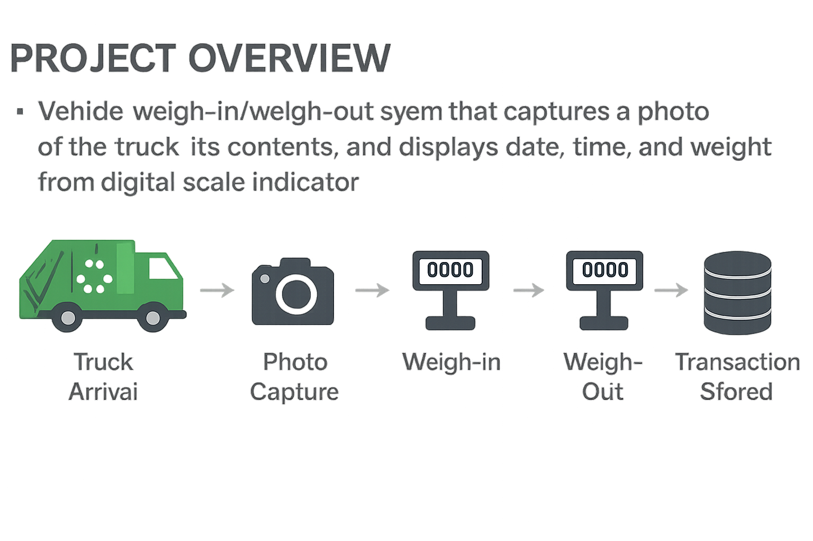
Workflow Diagram

Slide 15
Deliverables
Continuous monitoring and read of a scale weight measurement stream
When a vehicle sized weight is indicated, trigger video recording
Attempt identify vehicle by “OCRing” the vehicle license plate and performing a lookup in local database of license plates of customer vehicles
Record stable weight
Create an image of the vehicle, with a date/time and weight overlay
Store image in local database under customer’s transaction record
If license plate match is not found or cannot be seen or determined, store transaction in “needs_review” table in database for human review
Machine Learning model for license plate recognition
Machine Learning model to identify contents of vehicle (Trans, Recycling, Metal, Construction Debris, etc.)

Slide 16
THANK YOU!
Let’s build something awesome!!!

